Slide 1

Predict movie tagline from text synopsis
International Institute of Technology - Hyderabad
SMAI - SPRING 2019 Course Project
Project ID - 11
Team 31- PGSSP ML TECHNIES
Project guide : Satyam mittal
Project members : Jyothsna – Madan – Surekha - Karthikeyan

Slide 2
Abstract
To predict the tagline of a movie from given text synopsis.
NLP Problem
Abstractive Summarization
Our Approach

Slide 3
Given Problem Statement
Predicting Movie Tagline for any Given Movie Synopsis
Movie Tagline are Nothing but Abstract Summary of the movie.
Hence this is a Text Abstraction - NLP Problem

Slide 4
Challenges
Data:
Missing values (Either in Plot Synopsis or Movie tagline)
Non UTF8 Text contents ( such as tm or copyright symbols etc.)
Non English Text Contents ( Text written in regional Language fonts which are not a English char)
Notes:
Data processing – Missing values , non UTF8 Characters Clean up.
Huge volume of Training – Solution – Check points
Review comment - Add some examples

Slide 5
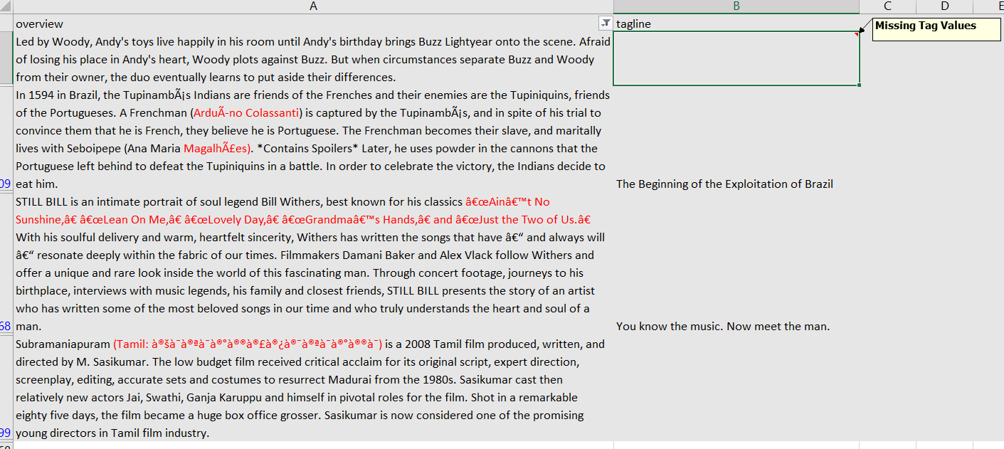
Challenges
Notes:
Data processing – Missing values , non UTF8 Characters Clean up.
Huge volume of Training – Solution – Check points
Review comment - Add some examples

Slide 6
Challenges – Cont.
Training Model:
Huge Volume of data to be processed
Computation complexity leads to Long hours of training
Risk of Losing training data while executing training for long hours – Alternatively we used Checkpoints to save progress of the training.

Slide 7
Challenges – Cont.
Unknown words in Data set:
There is always possibility of getting a Unknown word which is not part of word embedding matrix which we created. i.e Out of Vocabulary Words
Examples : Name of Characters in the movie like Sivagami, Baahubali etc.
Notes:
Data processing – Missing values , non UTF8 Characters Clean up.
Huge volume of Training – Solution – Check points

Slide 8
Challenges – Cont.
Training Model:
Huge Volume of data to be processed
Computation complexity leads to Long hours of training
Risk of Losing training data while executing training for long hours – Alternatively we used Checkpoints to save progress of the training.
Notes:
Data processing – Missing values , non UTF8 Characters Clean up.
Huge volume of Training – Solution – Check points

Slide 9
Implementation Details
Bi Directional – Encoder decoder LSTM
TensorFlow based implementation.
Batch processing of Data
Notes:
Extraction vs abstraction - Abstraction Why Abstraction ? – Get Some Few sentence from Jythosna
LSTM Configuration – Bi Directional for Encoding -
List of Hyper parameters
Batch processing and Training Stop Criteria
Data Cleaning Consideration
Reports for Data Summary
4Image taken from blog, www.abigailsee.com – Presentation PDF – Page #27

Slide 10
Implementation Details , Cont.
Word Vector Embedding .
Numberbatch word embedding* is built on:
ConceptNet 5.5,
GloVe,
word2vec,
Parallel text from OpenSubtitles 2016
* Refer GitHub Repository mentioned in the reference section
Notes:
Extraction vs abstraction - Abstraction Why Abstraction ? – Get Some Few sentence from Jythosna
LSTM Configuration – Bi Directional for Encoding -
List of Hyper parameters
Batch processing and Training Stop Criteria
Data Cleaning Consideration
Reports for Data Summary
4Image taken from blog, www.abigailsee.com – Presentation PDF – Page #27

Slide 11
Implementation Details , Cont.
Intermediate Training Data/Weights is saved as Check points.
Can be Loaded back to system later.
More training data can be trained on top of existing Checkpoint.
Saved Check point can be distributed as Binary file to others to deploy the model
Training Stop Criteria – Add Some explanation to this
Notes:
Extraction vs abstraction - Abstraction Why Abstraction ? – Get Some Few sentence from Jythosna
LSTM Configuration – Bi Directional for Encoding -
List of Hyper parameters
Batch processing and Training Stop Criteria
Data Cleaning Consideration
Reports for Data Summary
4Image taken from blog, www.abigailsee.com – Presentation PDF – Page #27

Slide 12
Demo

Slide 13
Future works
To Extend this work to Indian Regional Languages
Challenge with Language Corpus
Notes:
Regional Language – Check with Surekha for Word embedding model

Slide 14
References – Part 1
Predicting Movie Genres Based on Plot Summaries by Quan Hoang : https://arxiv.org/pdf/1801.04813.pdf
Folksonomication: Predicting Tags for Movies from Plot Synopses UsingEmotion Flow Encoded Neural Network by Sudipta Kar, Suraj Maharjan and Thamar Solorio - https://aclweb.org/anthology/C18-1244
Patent Abstract Summarization using Recurrent Neural Networks by Abhishek Jindal,Chirag Choudhary and Nile Hanov –https://github.com/ajindal1/Text_Summarizer_On_Patents/blob/master/project_report/Text_Summarization_project_NLP.pdf

Slide 15
References – Part 2
Data Source:
Found in Kaggle - https://www.kaggle.com/rounakbanik/the-movies-dataset
Filename : movies_metadata.csv
Concept Net Number batch – https://github.com/commonsense/conceptnet-numberbatch
Glove - https://nlp.stanford.edu/projects/glove/

Slide 16
References – Part 3
Rouge Score: https://stats.stackexchange.com/questions/301626/interpreting-rouge-scores
Performance metrics - https://nlpprogress.com/english/summarization.html
RNN – Sequence to Sequence Model : https://towardsdatascience.com/seq2seq-model-in-tensorflow-ec0c557e560f

Slide 17
Thank you!

